Slide 1
Searching Algorithms Linear Search & Binary Search

Slide 2
Searching Techniques
Searching refers to the operation of finding the location of a given item in a collection of data.
The Searching refers to the operation of finding the location of a given item in a collection of data.
The search is said to be successful if the item appears in the data and unsuccessful otherwise.
The algorithm chosen for searching depends on the way information is organized.
The two simple searching algorithm s are:
Linear Search
Binary Search

Slide 3
Linear Search
In computer science, linear search is a search algorithm, also known as sequential search, that is suitable for searching a list of data for a particular value.
It operates by checking every element of a list one at a time in sequence until a match is found.

Slide 4
Linear Search Algorithm
DATA is the linear array with N elements and ITEM is a given item of information. This algorithm finds the location LOC of ITEM, or sets LOC=0 if the search is unsuccessful.
[Initialize counter] Set K=1
Repeat steps 3 while K< N and DATA[K] != ITEM
[Increment counter]Set K=K+1
[End of step 2 loop]
[Successful] LOC=K
If LOC = 0 then:
Write: ITEM is not in the array DATA
Else:
Write: LOC is the location of ITEM
[End of If structure]
Exit.

Slide 5
Example
Consider the following array that stores the marks of students.
Search 13.5 and print its location.
Search the lowest marks and print its location.
Search the highest marks and print is location.
Search the average marks and print its location.

Slide 6
Complexity/Efficiency of Linear Search
The complexity of search algorithms is measured by the number f(n) of comparisons required to find item in data consisting of n elements.
The algorithm is called linear search because its complexity/efficiency can be expressed as a linear function: the number of comparisons to find a target increases linearly as the size of the data.
For search algorithms, the main steps are the comparisons of items with the target value. Counting these for data models representing the best case, the worst case, and the average case produces the following table. For each case, the number of steps is expressed in terms of n, the number of items in the data.

Slide 7
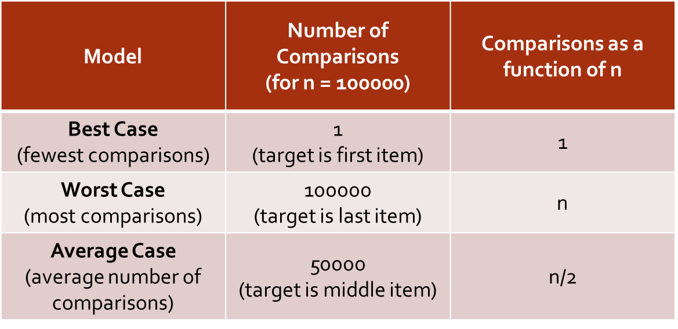
Complexity/Efficiency of Linear Search
For search algorithms, the main steps are the comparisons of items with the target value. Counting these for data models representing the best case, the worst case, and the average case produces the following table. For each case, the number of steps is expressed in terms of n, the number of items in the data.

Slide 8
Binary Search
A binary search, also called a dichotomizing search, is a more efficient algorithm if the data is sorted, in increasing order.
The strategy of binary search is to check the middle (approximately) item in the list.
If it is not the target and the target is smaller than the middle item, the target must be in the first half of the list.
If the target is larger than the middle item, the target must be in the last half of the list.
Thus, one unsuccessful comparison reduces the number of items left to check by half!

Slide 9
Binary Search
The search continues by checking the middle item in the remaining half of the list.
If it's not the target, the search narrows to the half of the remaining part of the list that the target could be in.
The splitting process continues until the target is located or the remaining list consists of only one item. If that item is not the target, then it's not in the list.

Slide 10
Binary Search Algorithm
DATA is the sorted array with lower bound LB and upper bound UB and ITEM is a given item of information. This algorithm finds the location LOC of ITEM, or sets LOC=0 if the search is unsuccessful. The variables BEG,END and MID denotes respectively the beginning, end and middle location.
[Initialize variables] Set BEG=LB, END=UB and MID = INT((BEG+END)/2)
Repeat steps 3 and 4 while BEG< END and DATA[MID] != ITEM
if ITEM < DATA[MID], then:
ID], thenSet END=MID-1
else:
Set BEG=MID+1
4. Set MID=INT((BEG+END)/2 [End of step 2 loop]
If DATA[MID]==ITEM, then
Set LOC=MID
Else:
Set LOC=0
Exit.

Slide 11
Example
Let DATA be the following sorted 13 elements array;
DATA
while(beg<=end && DATA[MID]!=ITEM
while(1<=13 && DATA[7]!=40)
while(1<=13 && 55!=40) true
if (40<55) true
end=7-1=6
11 | 22 | 30 | 33 | 40 | 44 | 55 | 60 | 66 | 77 | 80 | 88 | 99
BEG | END | MID
1 | 13 | 7

Slide 12
Example
while(beg<=end && DATA[MID]!=ITEM
while(1<=6 && DATA[3]!=40)
while(1<=13 && 30!=40) true
if (40<33) false
beg=3+1=4
Mid=(6+4)/2=5
while(4<=6 && DATA[5]!=40)
while(4<=6&& 40!=40) false
if(DATA[MID]==ITEM)
if(40==40)
LOC=MID=5(item found at location 5)
BEG | END | MID
1 | 13 | 7
1 | 6 | 3
4 | 6 | 5

Slide 13
Complexity/Efficiency of Binary Search
To evaluate binary search, the number of comparisons in the best case and worst case are compared.
The best case occurs if the middle item happens to be the target. Then only one comparison is needed to find it. As before, the best case analysis does not reveal much.
If the target is not in the array then the process of dividing the list in half continues until there is only one item left to check.

Slide 14
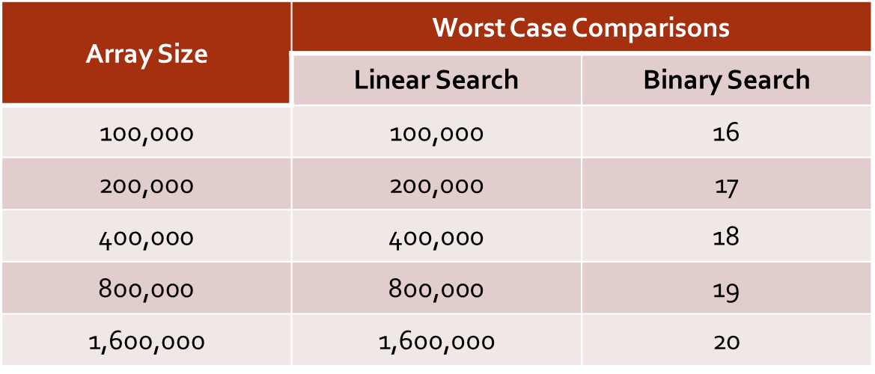
Efficiency Comparison

Slide 15
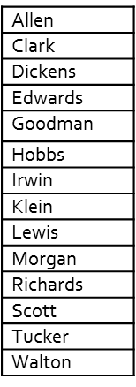
Execise
Consider alphabetized Linear array NAME
Using linear search algorithm, how many comparisons are used to locate Hobbs, Morgan and Fisher?
b. Suppose binary search algorithm is applied to the array NAME to find the location of Goodman. Find the ends BEG and END and the MID for the test segment in each step of the algorithm

Slide 16
Questions & answers

